Slide 1
OVS, DPDK and Software Dataplane Acceleration
OVS Fall Conference
November 17th, 2015

Slide 2
Who are we?
Thomas F. Herbert
Red Hat
therbert@redhat.com
Kevin Traynor
Intel
kevin.traynor@intel.com

Slide 3
Open vSwitch with DPDK
User space
User space
Openflow Processing
Openflow Processing
Megaflow Cache
Microflow Cache
PMD
PMD
PMD
Kernel space
Kernel space
Netlink
Megaflow Cache
Microflow Cache
NIC
NIC
NIC

Slide 4
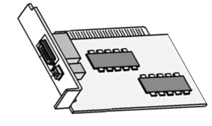
OVS Architectural Evolution
OpenDaylight
ovsdb
OpenFlow
Compute Node:
User Space
VNF
Virtio
Qemu
ovsdb server
ovs-vswitchd
netdev
netdev_vport
netdev_linux
netdev-dpdk
VNF
Virtio
Qemu
ofproto
DPDK
librte_vhost
dpif-linux (Kernel Space Forwarding – Control Only)
dpif-netdev (User Space Forwarding)
Overlays
sockets
DPDK
librte_ring
VNF
Ivshmem
Qemu
DPDK
DPDK
librte_eth
openvswitch.ko
Compute Node:
Kernel Space
OVS Fall Conference 2015

Slide 5
The Netdev Interface Makes it Possible
Transparency of Data Plane
Netdev – API Between Data Plane and OVS
Generic network device API independent from data plane implementation.
Similar to network driver interface in BSD
Netdev Abstracts forwarding of packets in data plane
Conceptually like any Network device driver
With Start, Stop, Private Data Area, Queue Management
Struct netdev Holds the interface Specific Function Pointers
Includes the generic part followed by private part for use by driver.
Constructur for netdev provider
Dpdk Creates dpdk personality of struct netdev
Multiple rx queues Managed by OVS

Slide 6
Open vSwitch with DPDK
DPDK – Data Plane Development Kit
About 4 Years Old
First Integrated with OVS from 2013
Fast Packet Forwarding
Poll Mode Drivers
Uses Commodity Hardware
Multiple Threads and Cores
Up to 12X Speed Improvement for small packets
Over 15mpps Forwarding
Small Packets
Disadvantages WRT Linux Kernel
Linux Data Plane Has
Complete TCP/IP Stack
20 years of development
Rich Debugging Options
Promiscuous IFs
Access to Wide Variety of Network IF’s and VF’s
Tunnels and Endpoints

Slide 7
Open vSwitch with DPDK User Perspective
Who Uses OVS/DPDK
Open vSwitch
Open Stack/Neutron via ODL Plugin and OVS
OVS CLI Tools
Programmers - Application Developers of
Other Packet consumers, DPI, Classifiers
Infrastructure – Routers, Firewalls, Services
Other Packet consumers, DPI, Classifiers
Typical Scenario
NF’s in VMs or Containers
Service Function Chaining
Real World Performance
Challenge: DPDK Gains Over Wide Variety of Use Cases

Slide 8
Open vSwitch with DPDK Usability Story
In the Beginning: My user Story starts in 2013
Inspired by Intel presentation of DPDK at ONS 2013
Developing Network Threat Analyzer
Integrated Open vSwitch
Traffic shaping, threat blocking and mitigation
Requirement: 10Gb without Adding $10K to $20K on custom HW Switch Fabric.
DPDK is the Answer?
How to prove the OVS/DPDK Claim?
Started with DPDK 1.7.1 and OVS 2.3
Scary: poor integration --Not integrated with OVS
Compilation issues, conflicting APIs. ABIs, OVS Versions
Three Confusing Forks:
DPDK.org
DPI Fork with custom API
01.org
Came Together with DPDK 1.8
Integrated: Master Branch OVS
I Ran DPDK on guest with VirtIO/VMXnet3 saw 2.5X perf gain
Developed App using DPDK-ring to feed DPI
Now: DPDK 2.1 with OVS: Much improved!

Slide 9
Improving Open vSwitch with DPDK
Is DPDK really still Experimental?
Is it time for this patch?
--- a/INSTALL.DPDK.md
+++ a/INSTALL.DPDK.md
@@ -5,8 +5,8 @@ Open vSwitch can use Intel® DPDK lib to operate entirely in
Userspace. This file explains how to install and use Open vSwitch in such a mode.
-The DPDK support of Open vSwitch is considered experimental.
-It has not been thoroughly tested.
This version of Open vSwitch should be built manually with `configure` and `make`.
Issues with DPDK:
How to Improve?
This thread, http://openvswitch.org/pipermail/dev/2015-August/058814.html
Some Suggestions from Thread
Device management:
Udev/systemd – (Flavio Leitner)
Device creation, binding, destruction – handled by Host OS

Slide 10
Improving DPDK in Open vSwitch
How About Debugging?
TcpDump like capability
Use “Mirroring” of packets to pmd/libpcap or libpcap-ng
How About Test Frameworks for DPDK
Add CI for Data Plane Testing
Vsperf Project in OPNFV
Support Only One type of vhost device
Drop Vhost – Cuse
Better Documentation
Recent Patch to INSTALL.DPDK.md
Education About Optimization Cache and Numa
From lstopo to Optimum DPDK
Device Management
Driverctl utility for Fedora

Slide 11


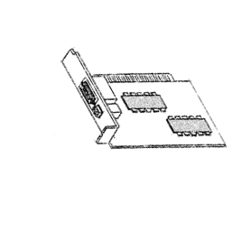
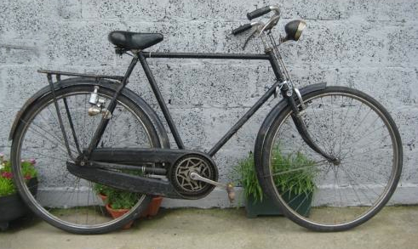
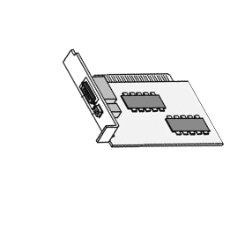
Tuning – Core Affinities
OVS

Slide 12
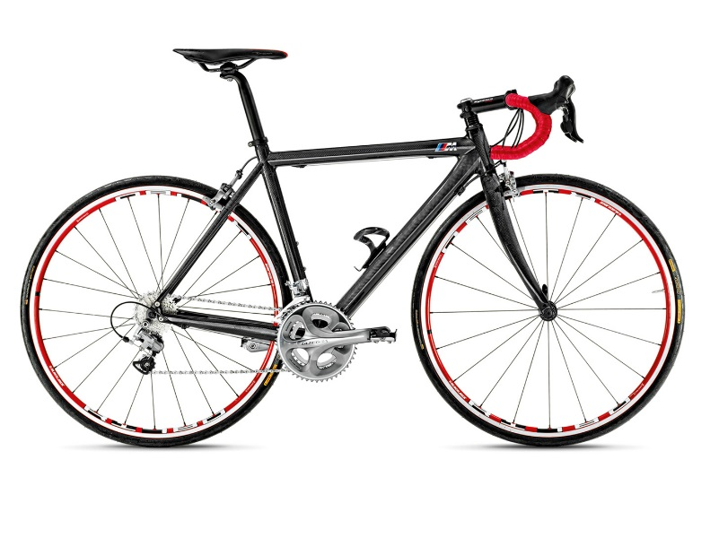
Tuning – Core Affinities
OVS
ovs-vsctl set Open_vSwitch . other_config:pmd-cpu-mask=2

Slide 13
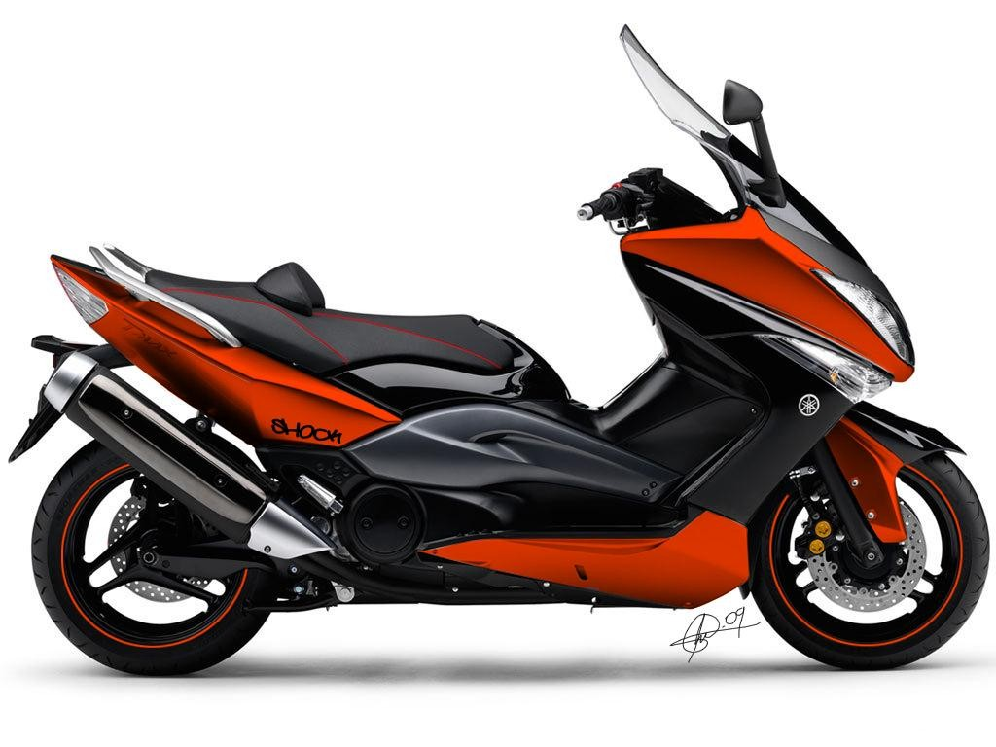
Tuning – Core Affinities
OVS
ovs-vsctl set Open_vSwitch . other_config:pmd-cpu-mask=6

Slide 14
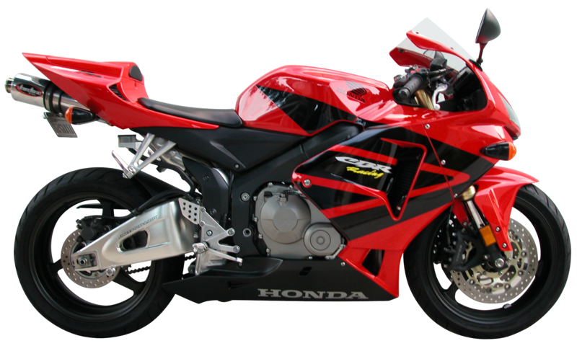
Tuning – Core Affinities
OVS
ovs-vsctl set Open_vSwitch . other_config:pmd-cpu-mask=1806

Slide 15

Tuning – Multiqueue
OVS
ovs-vsctl set Open_vSwitch . other_config:pmd-cpu-mask=781E
ovs-vsctl set Open_vSwitch . other_config:n-dpdk-rxqs=2

Slide 16

Usability Guides
Instructions for setup
https://github.com/openvswitch/ovs/blob/master/INSTALL.DPDK.md#using-open-vswitch-with-dpdk
Performance tuning
https://github.com/openvswitch/ovs/blob/master/INSTALL.DPDK.md#performance-tuning
https://download.01.org/packet-processing/ONPS1.5/Intel_ONP_Server_Release_1.5_Performance_Test_Report_Rev1.2.pdf

Slide 17

Availability: Distro Packages and Git
ISV and OSV recognizing the progress of OVS with DPDK
Centos7: 7.4: DPDK 2.1; 7.2: OVS 2.4
Fedora: F23;F22 updates DPDK 2.0; F24: DPDK 2.1
Fedora Copr repo for latest:https://copr.fedoraproject.org/coprs/pmatilai/dpdk/
Red Hat OSP8...soon:
OVS/DPDK Integrated with Neutron
Ubuntu: 15.10: OVS with DPDK package
OVSNFV OPNFV Project planning deployment in future OPNFV releases
https://01.org/packet-processing/intel%C2%AE-onp-servers
git clone http://dpdk.org/git/dpdk
git clone https://github.com/openvswitch/ovs.git

Slide 18
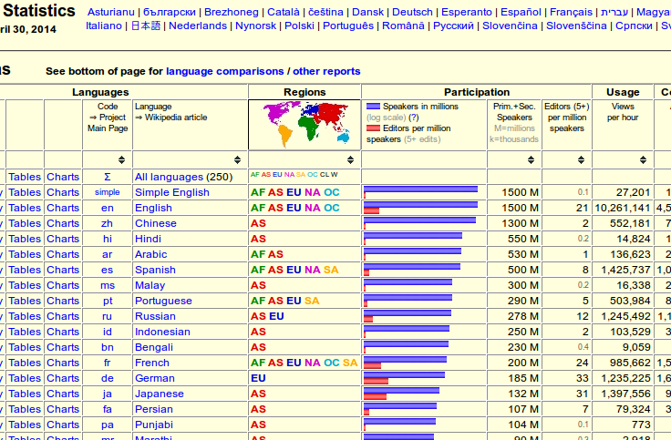
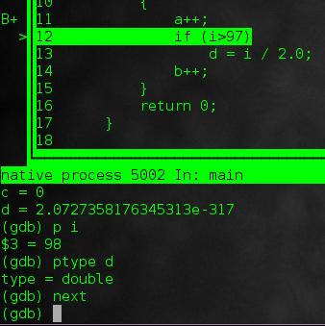
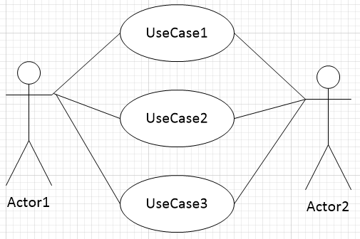
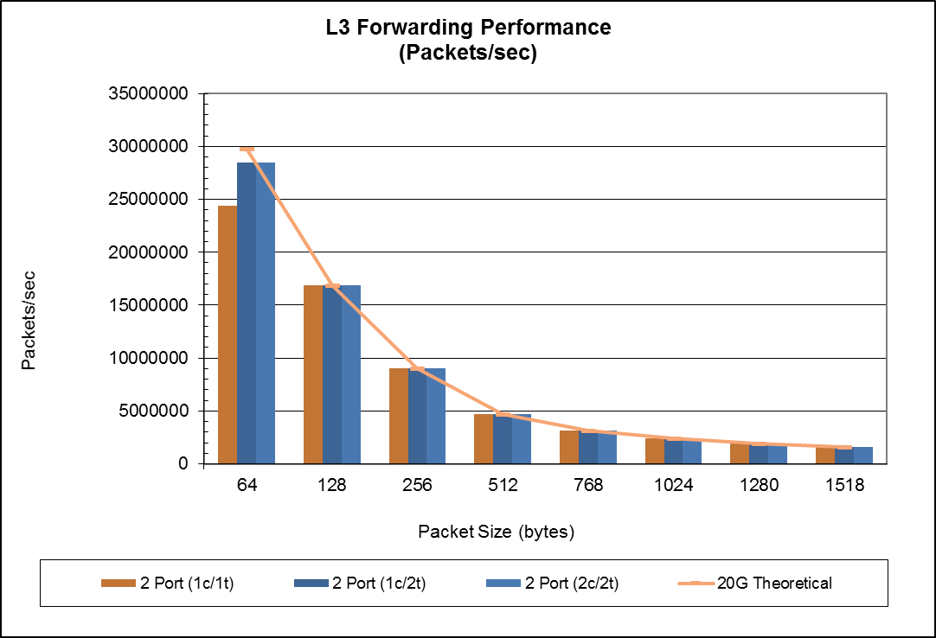
Conclusion
“It just works”

Slide 19
Conclusion
“It just works”

Slide 20
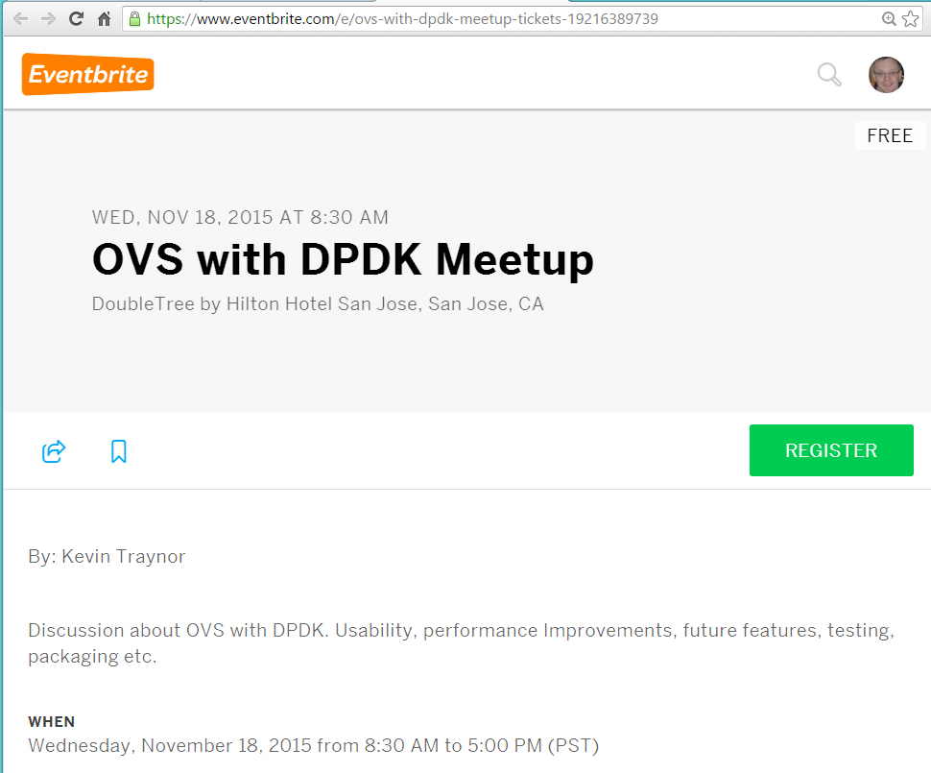
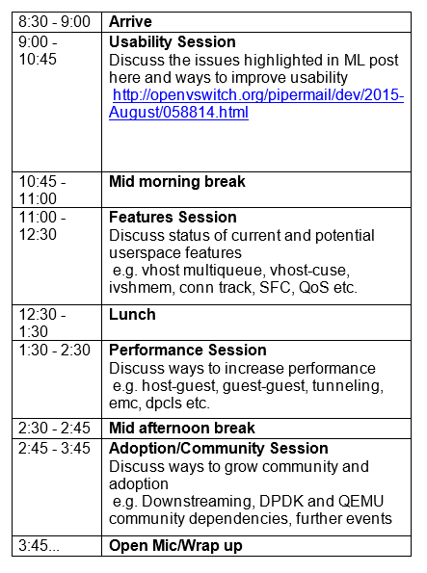
OVS with DPDK Meetup
https://www.eventbrite.com/e/ovs-with-dpdk-meetup-tickets-19216389739

Slide 21
Legal Disclaimer
INFORMATION IN THIS DOCUMENT IS PROVIDED IN CONNECTION WITH INTEL PRODUCTS. NO LICENSE, EXPRESS OR IMPLIED, BY ESTOPPEL OR OTHERWISE, TO ANY INTELLECTUAL PROPERTY RIGHTS IS GRANTED BY THIS DOCUMENT. EXCEPT AS PROVIDED IN INTEL'S TERMS AND CONDITIONS OF SALE FOR SUCH PRODUCTS, INTEL ASSUMES NO LIABILITY WHATSOEVER AND INTEL DISCLAIMS ANY EXPRESS OR IMPLIED WARRANTY, RELATING TO SALE AND/OR USE OF INTEL PRODUCTS INCLUDING LIABILITY OR WARRANTIES RELATING TO FITNESS FOR A PARTICULAR PURPOSE, MERCHANTABILITY, OR INFRINGEMENT OF ANY PATENT, COPYRIGHT OR OTHER INTELLECTUAL PROPERTY RIGHT.
A "Mission Critical Application" is any application in which failure of the Intel Product could result, directly or indirectly, in personal injury or death. SHOULD YOU PURCHASE OR USE INTEL'S PRODUCTS FOR ANY SUCH MISSION CRITICAL APPLICATION, YOU SHALL INDEMNIFY AND HOLD INTEL AND ITS SUBSIDIARIES, SUBCONTRACTORS AND AFFILIATES, AND THE DIRECTORS, OFFICERS, AND EMPLOYEES OF EACH, HARMLESS AGAINST ALL CLAIMS COSTS, DAMAGES, AND EXPENSES AND REASONABLE ATTORNEYS' FEES ARISING OUT OF, DIRECTLY OR INDIRECTLY, ANY CLAIM OF PRODUCT LIABILITY, PERSONAL INJURY, OR DEATH ARISING IN ANY WAY OUT OF SUCH MISSION CRITICAL APPLICATION, WHETHER OR NOT INTEL OR ITS SUBCONTRACTOR WAS NEGLIGENT IN THE DESIGN, MANUFACTURE, OR WARNING OF THE INTEL PRODUCT OR ANY OF ITS PARTS.
Intel may make changes to specifications and product descriptions at any time, without notice. Designers must not rely on the absence or characteristics of any features or instructions marked "reserved" or "undefined". Intel reserves these for future definition and shall have no responsibility whatsoever for conflicts or incompatibilities arising from future changes to them. The information here is subject to change without notice. Do not finalize a design with this information.
The products described in this document may contain design defects or errors known as errata which may cause the product to deviate from published specifications. Current characterized errata are available on request.
Contact your local Intel sales office or your distributor to obtain the latest specifications and before placing your product order.
Copies of documents which have an order number and are referenced in this document, or other Intel literature, may be obtained by calling 1-800-548-4725, or go to: www.intel.com/design/literature.htm
Intel processor numbers are not a measure of performance. Processor numbers differentiate features within each processor family, not across different processor families: Go to: Learn About Intel® Processor Numbers
Intel, the Intel logo, Itanium, Intel Atom, Intel Xeon Phi, Intel AppUp, and Xeon are trademarks of Intel Corporation in the U.S. and/or other countries.
*Other names and brands may be claimed as the property of others.
Copyright © 2014 Intel Corporation. All rights reserved

Slide 22
Questions?

